Slide 1
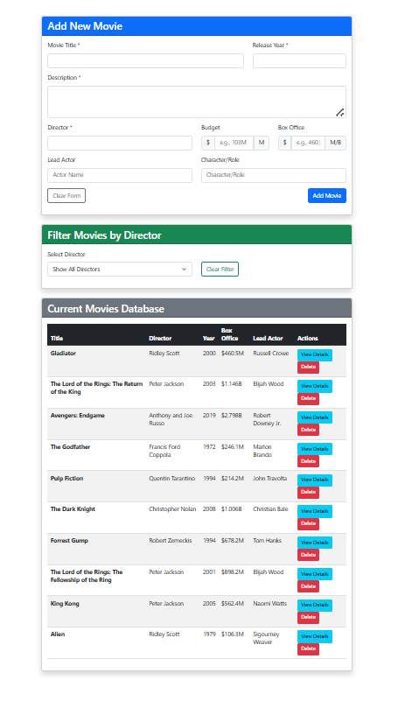
Using the JSON data supplied in this assignment
Add a Delete button on each movie. When the user deletes a movie, remove the movie and redraw the screen
Change this layout from a ‘card’ based to an html bootstrap striped table (see example)
At the top … create a form to add new movie:
Shows a fully responsive html form for all the movie data. For Simplicity only accept 1 actor and role
When the user creates a new movie then add it to the json file and redraw the screen.
Add validation code to this form (Note: Do NOT rely on HTML5 browser validation - you must write custom JavaScript validation functions) with the following rules
Movie title – at least 3 characters
Release year - from 1880 to current year
Description – at least 10 characters but not more that 500
Director – at least 3 characters
Budget – must be a number $1000 or more and less than 1,000 Billion (1 to 1000 Million)
Lead actor – Must be at least 2 words and more than 3 characters
Role – must be at least 3 characters.
i. Make the errors appear in red under each item in red (see example next slide)
ii. Note if multiple errors occur, then you should show ALL of them (not just the first
one you find.
h. Success Feedback: "Show a success message when a movie is successfully added“. This success message should appear in a blue alert box above the "Current Movies Database" table
Create a drop down BASED on the JSON data of valid directors from the data. If selected then show the movies from that director only in the table. DO NOT HARD CODE THE DIRECTORS.
Other notes – Use fetch with json webserver to get the data. Make sure to update this data when deleting and inserting new movies

Slide 2
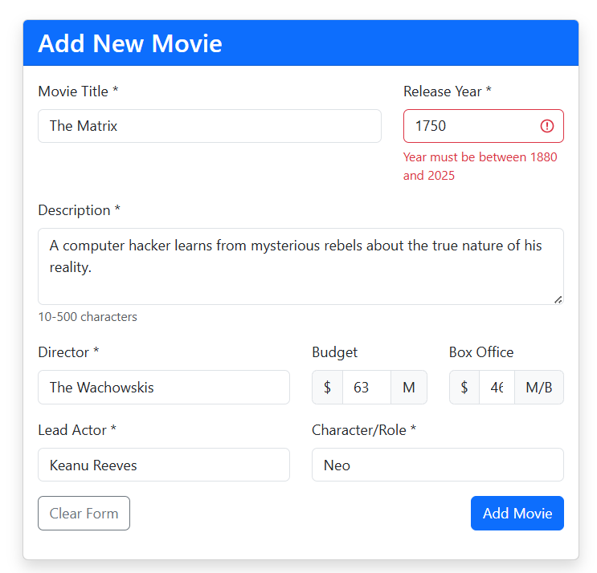

Slide 3
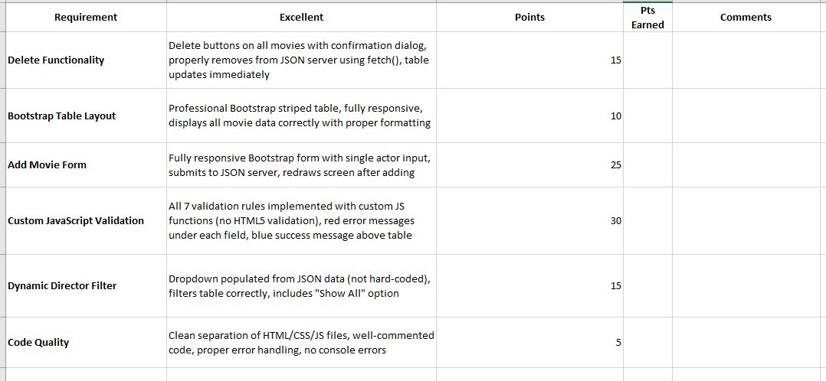
Common Deductions
Using HTML5 validation instead of custom JavaScript
Hard-coded directors
Console errors or broken functionality
Excessive data dumped to the console. Keep code and console output clean
Needed files are not included, not separated correctly (html, js and css) or not all in 1 directory (see yellow box next slide)
Code does not properly use constants or is not well formatted or uses not standard variable names
Your code does not use an input file called movie_database.json running on port 3000

Slide 4
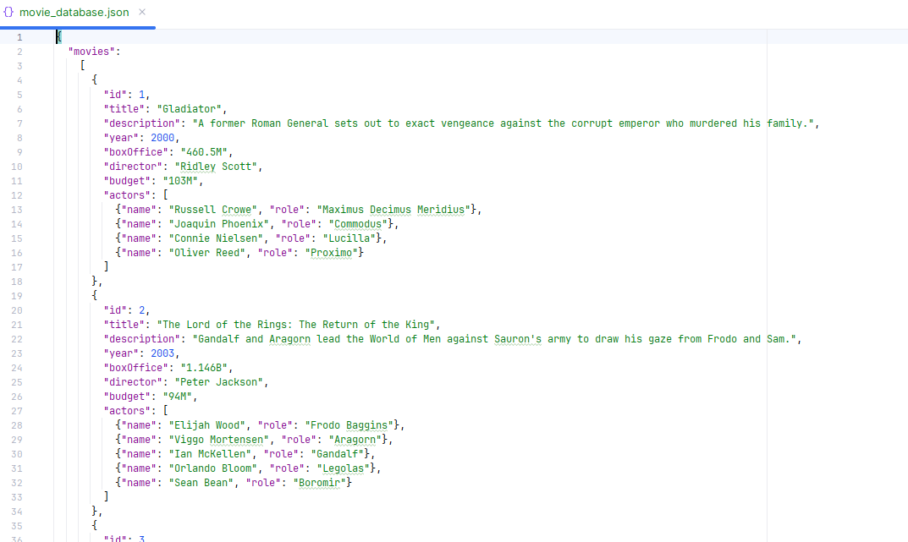
What to hand in
Important: All three files must be in the same folder/directory for easy grading. Do not create separate css/ or js/ subfolder
Important2: Make sure you use a file called movie_database.json running on port 3000 . I do not want to guess your port number when running and grading your code
Movie Database Assignment - Grading Rubric & Submission Requirements
What to Hand In
File Structure Requirements
Submit your complete assignment as exactly 3 files:
index.html - Main HTML file containing:
Bootstrap responsive form for adding movies
Bootstrap striped table for displaying movies
Director filter dropdown
Movie details modal
All HTML structure and content
styles.css - CSS file containing:
Custom validation error styling
Success message styling
Any additional custom styles beyond Bootstrap
Responsive design enhancements
script.js - JavaScript file containing:
All validation functions
API/fetch operations for CRUD functionality
Dynamic table updates
Director filtering logic
All interactive functionality

